Slide 1
Foundational Data Science in R

Slide 2
LESSON 1
Introduction to Data Science and R Programming

Slide 3
Introduction
R is a programming language and free software developed by Ross Ihaka and Robert Gentleman in 1993.
R possesses an extensive catalog of statistical and graphical methods. It includes machine learning algorithms, linear regression, time series, statistical inference to name a few.
R is a state-of-the-art programming language for statistical computing, data analysis, and machine learning. It has been around for almost three decades with over 12,000 packages available for download on CRAN.
Data analysis with R is done in a series of steps
Program: R is a clear and accessible programming tool
Transform: R is made up of a collection of libraries designed specifically for data science
Discover: Investigate the data, refine your hypothesis and analyze them
Model: R provides a wide array of tools to capture the right model for your data
Communicate: Integrate codes, graphs, and outputs to a report with R Markdown or build Shiny apps to share with the world

Slide 4
Why use R
Free and open-source:
It is issued under the General Public License (GNU). This means that you can use all the functionalities of R for free without any restrictions or licensing requirements.
High-quality visualization:
It is famous for high-quality visualizations. R's ggplot2 is a detailed implementation of the grammar of graphics which you can easily implement intuitive and interactive graphs.
A language for data analytics and data science:
It isn't a general-purpose programming language. It's a specialized programming language for statistical computing.
Data science
Data science is the study that deals with vast volumes of data using modern tools and techniques to find unseen patterns, derive meaningful information, and make business decisions. Data science uses complex machine learning algorithms to build predictive models

Slide 5
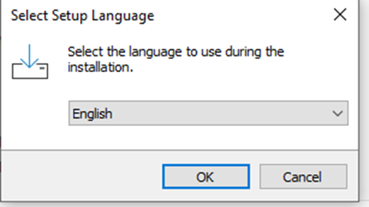
How to Download & Install R-Studio
R is a programming language. To use R, we need to install an Integrated Development Environment (IDE). Rstudio is the Best IDE available as it is user-friendly, open-source and is part of the Anaconda platform.
Download R; Go to https://cran.r-project.org/ website.
Click on "Download R for Windows".
Click on "install R for the first time" link to download the R executable (.exe) file.
Run the R executable file to start installation, and allow the app to make changes to your device.
Select the installation language.

Slide 6
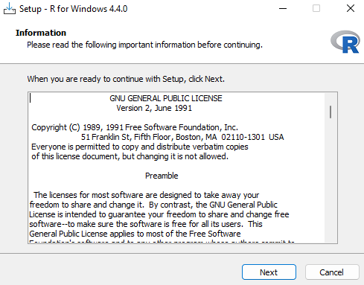
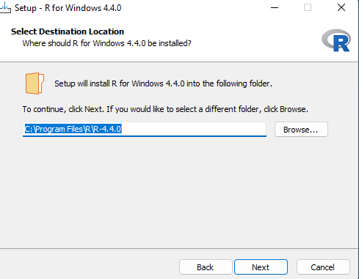
Follow the installation instructions.

Slide 7
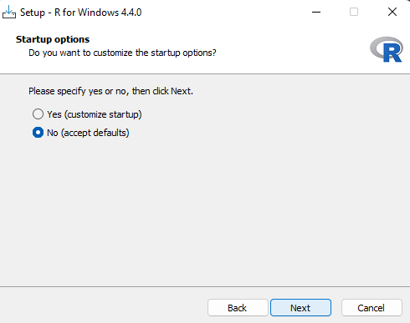
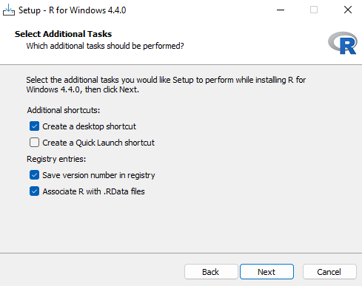
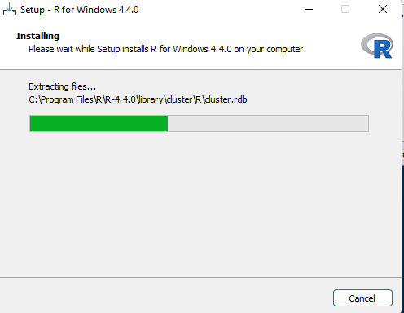
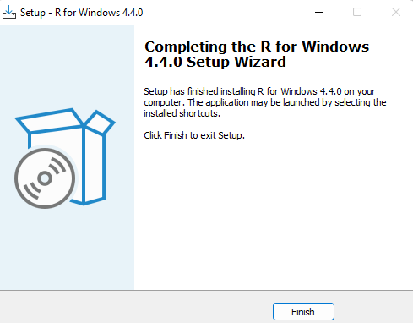
Click on "Finish" once installation is complete.

Slide 8
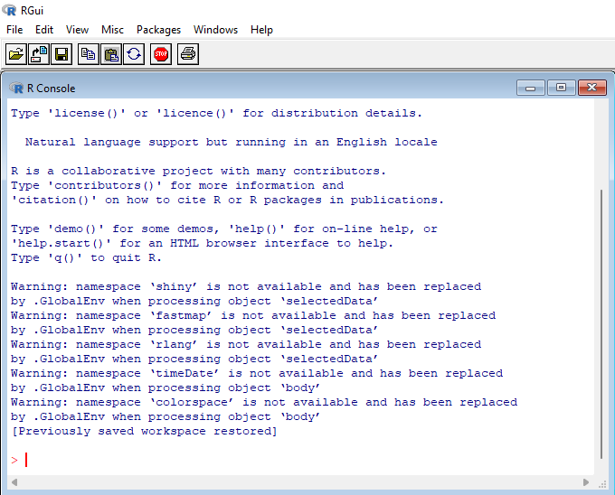
R has now been successfully installed on your Windows OS. Open the R GUI to start writing R codes

Slide 9
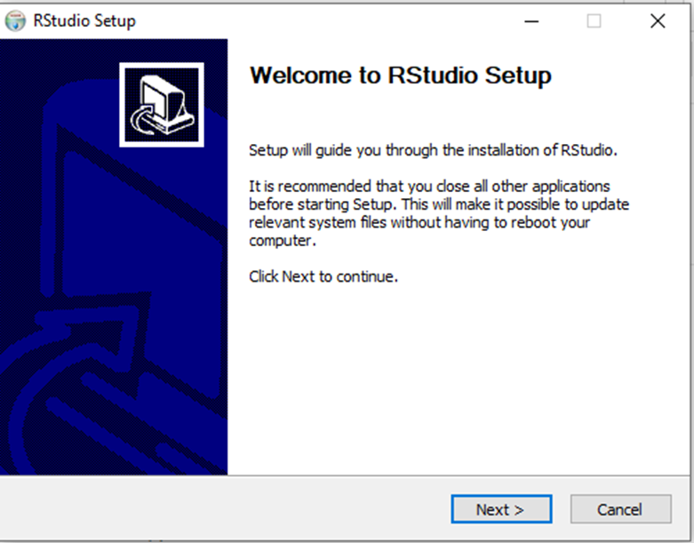
How to Download & Install R-Studio
Other than the R GUI, the other ways to interface with R include RStudio Integrated Development Environment (RStudio IDE). To run R on RStudio, you first need to install R on your computer. RStudio provide an interactive and friendly graphical interface to R that greatly improves users' experience. It is the Best IDE available as it is user-friendly, open-source and is part of the Anaconda platform.
Go to https://posit.co/download/rstudio-desktop/ website.
Click on "DOWNLOAD" in the top-right corner.
Click on "DOWNLOAD" under the "RStudio Open Source License".
Download RStudio Desktop recommended for your computer.
Run the RStudio Executable file (.exe) for Windows OS or the Apple Image Disk file (.dmg) for macOS X.

Slide 10
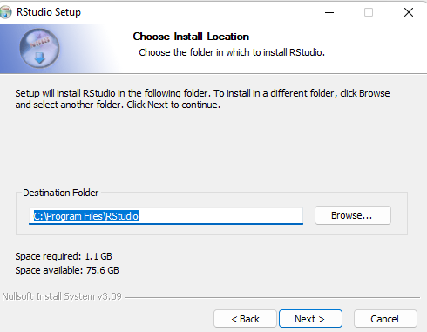
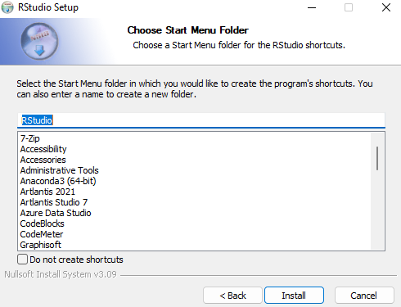
How to Download & Install R-Studio
Click on “Install“ to begin installation

Slide 11
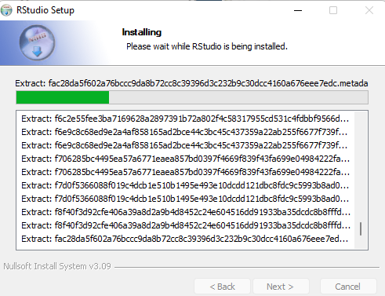
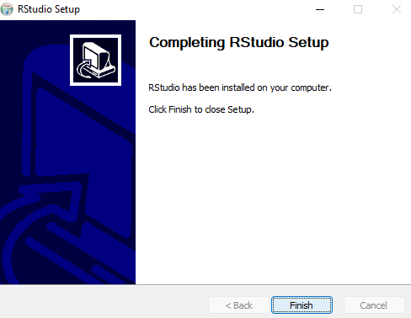
Click on "Finish" once installation is complete

Slide 12
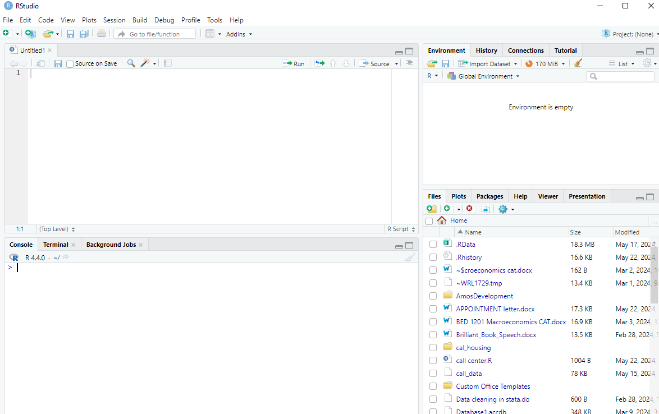
R-Studio Interface

Slide 13
Rstudio
Rstudio has four major parts
Source- This is where you will write and edit your R programs and documents.
Console - the place where commands written in the R language can be typed and executed immediately by the computer
History - shows every line of code executed in the current session.
Files/plots/packages/viewer -The Files tab has a navigable file manager, just like the file system on your operating system.
-The Packages tab shows you the packages that are installed and those that can be installed.
-The Plot tab is where graphics you create will appear. &nbsp;
-The Help tab allows you to search the R documentation for help and is where the help appears when you ask for it from the Console

Slide 14
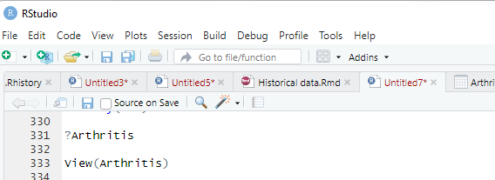
Packages
R packages are a collection of R functions, complied code and sample data. They are stored under a directory called "library" in the R environment.
Packages in R-gives R more functionality
To install a package-you must be connected to the internet
Help
The help() function and ? help operator in R provide access to the documentation pages for R functions, data sets, and other objects, both for packages in the standard R distribution and for contributed packages

Slide 15
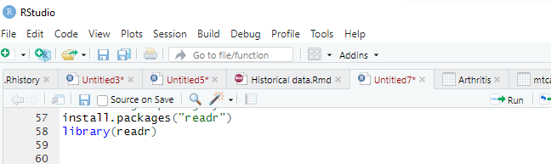
Loading Packages
Choose Install Packages from the Packages menu.
Select a package. (e.g. readr)
Then use the library(package) function to load it for use. (e.g. library(boot))
• For Linux Use the R Cmd Install

Slide 16
Data Types
Data Types or Data Structures in R Programming:
Scalars
Vectors (numerical, character, logical)
Matrices
Data frames
Lists
Basics types
4.5 is a decimal value called numerics.
4 is a natural value called integers. Integers are also numerics.
TRUE or FALSE is a Boolean value called logical binary operators in R.
The value inside ” ” or ‘ ‘ are text (string). They are called characters.
Creating a Variable
Use <- or =

Slide 17
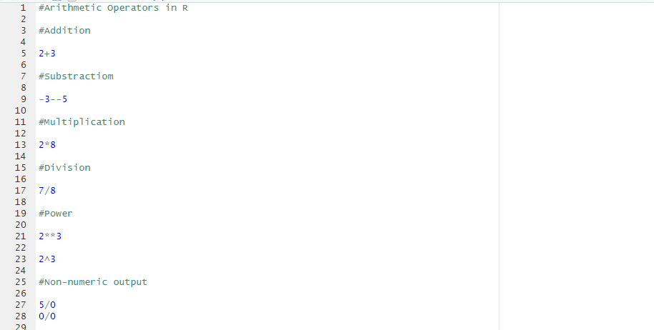
R Arithmetic Operators
Operator Description
+ Addition
– Subtraction
* Multiplication
/ Division
^ or ** Exponentiation
%% Modulo (remainder)

Slide 18
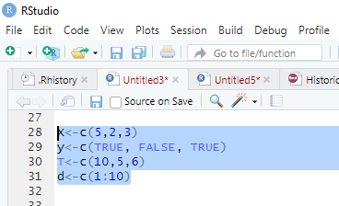
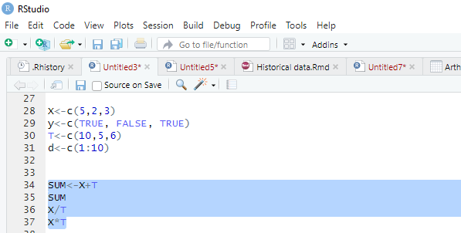
Vectors
A vector is a one dimensional order collection of data of the same type (one-dimensional array). We can create a vector with all the basic R data types we learnt before.
The simplest way to build vector data structures in R, is to use the concatenate (c) command.
Arithmetic operations on vectors

Slide 19
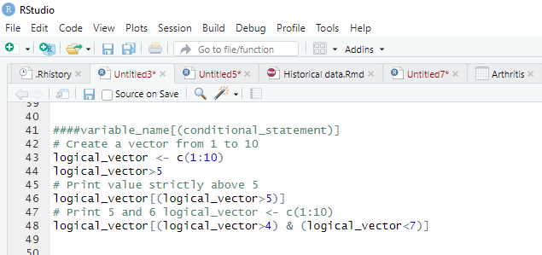
Logical Operators
Operator Description
== Exactly equal to
> Greater than
< Less than
>= Greater than or equal to
<= Less than or equal to
!= Not equal to
!x Not x
x y
x & y x AND y
isTRUE(x) Test if x is TRUE

Slide 20
LESSON 2
Data Preparation

Slide 21
Data preparation
Data preparation is the process of preparing raw data so that it is suitable for further processing and analysis
Data preparation steps
Gather data. The data preparation process begins with finding the right data. ...
Discover and assess data. After collecting the data, it is important to discover each dataset.
Cleanse and validate data.
Transform and enrich data.
Store data.

Slide 22
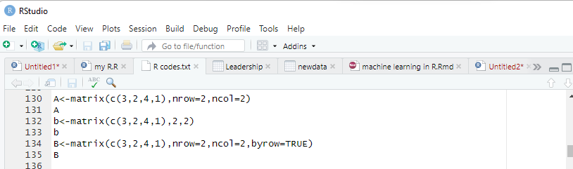
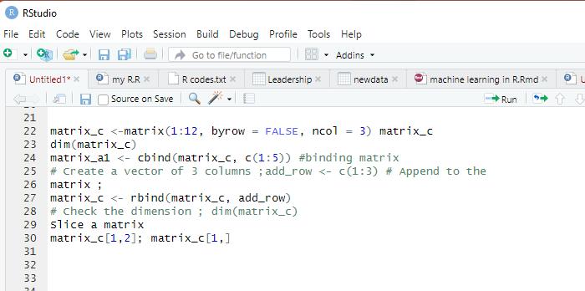
Matrix
A matrix function in R is a 2-dimensional array that has m number of rows and n number of columns. In other
words, matrix in R programming is a combination of two or more vectors with the same data type.
How to Create a Matrix in R and Append
» matrix(data, nrow, ncol, byrow = FALSE)

Slide 23
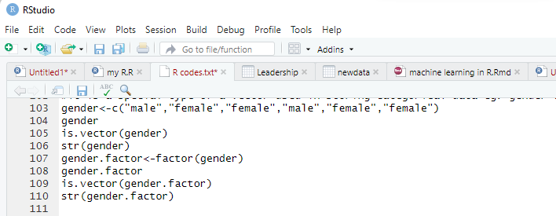
Factor in R
Factor in R is a variable used to categorize and store the data, having a limited number of different values. It is a special type of a vector used in storing categorical data
– In descriptive statistics for categorical variables in R, the value is limited and usually based on a particular finite
group. For example, a categorical variable in R can be countries, year, gender, occupation.
– A continuous variable, however, can take any values, from integer to decimal. For example, we can have the
revenue, price of a share, etc
• Categorical Variable (ordinal, nominal)
• Syntax; factor(x = character(), levels, labels = levels, ordered = is.ordered(x))

Slide 24
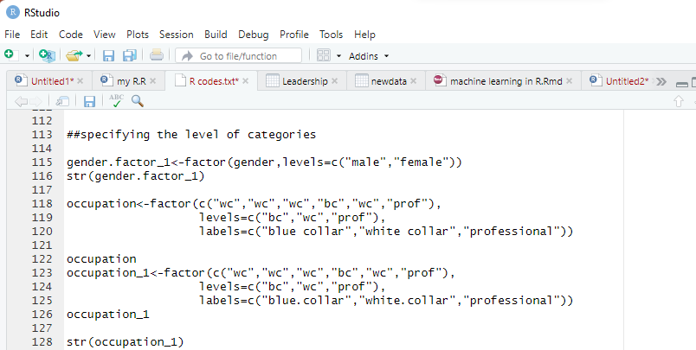
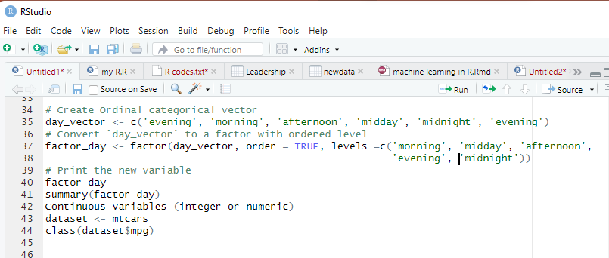
Factor in R cont…

Slide 25
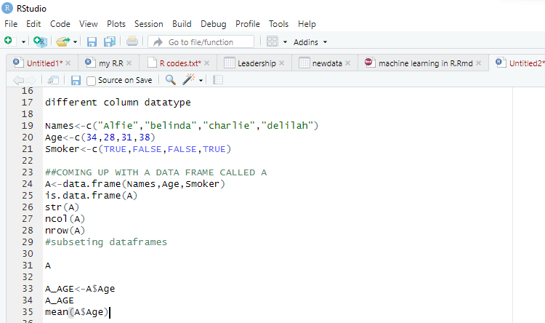
Data Frame
• A data frame is a list of vectors which are of equal length. A matrix contains only one type of data, while a data frame accepts different data types (numeric, character, factor, etc.)
• Syntax; data.frame(df, stringsAsFactors = TRUE)

Slide 26
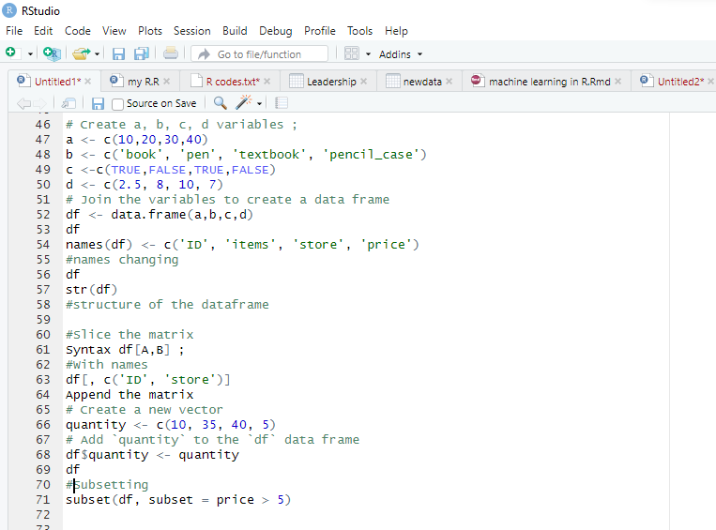

Slide 27
LESSON 3
Data & Introduction to Functions

Slide 28
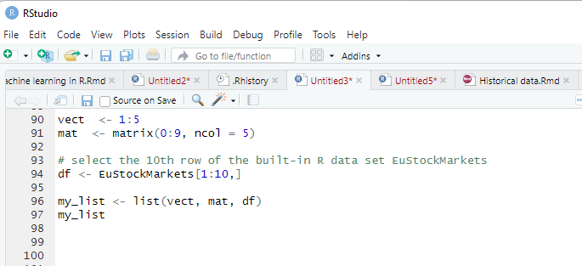
List
R List is also used to store a collection of objects and use them when we need them. R List is also used to store a collection of objects and use them when we need them.
Syntax of List list()
How to Create a List in R
Create a Vector
Create a Matrix
Create Data Frame
Create a List in R
Built-in Data Frame in R

Slide 29
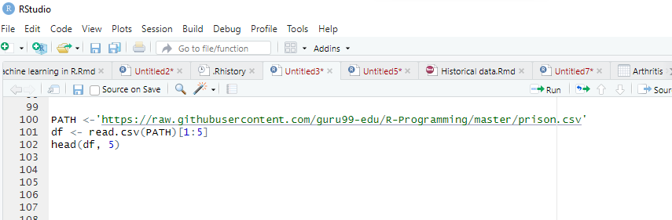
Built-in Data Frame in R
Before creating our own data frame, we can have a look at the R data set available online. The prison dataset is a 714×5 dimension. We can get a quick look at the bottom of the data frame with tail() function. By analogy, head() displays the top of the data frame. You can specify the number of rows shown with head (df, 5)
We can check the structure of the data frame with str:
str(df)

Slide 30
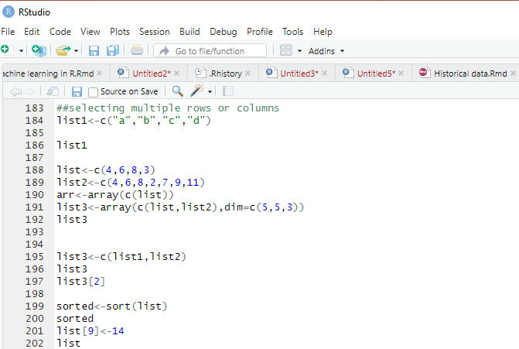

Slide 31
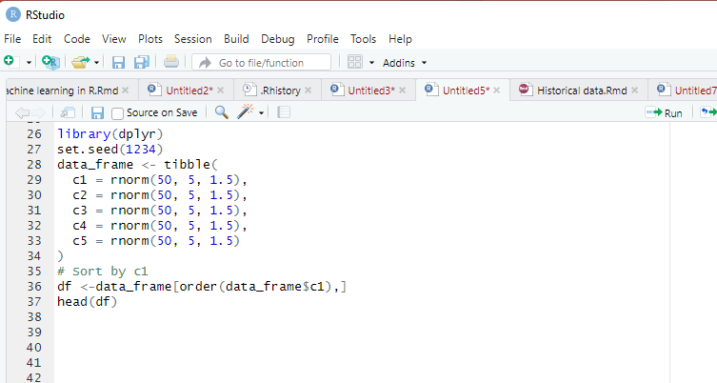
Sort
In data analysis you can sort your data according to a certain variable in the dataset. In R, we can use the help of the function order().
Syntax; sort(x, decreasing = FALSE, na.last = TRUE)
Example
we can create a tibble data frame and sort one or multiple variables.
A tibble data frame is a new approach to data frame. It improves the syntax of data frame and avoid frustrating data type formatting, especially for character to factor. It is also a convenient way to create a data frame by hand, which is our purpose here

Slide 32
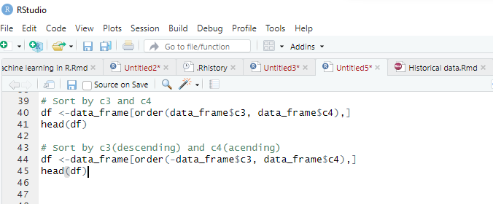
Sort cont….

Slide 33
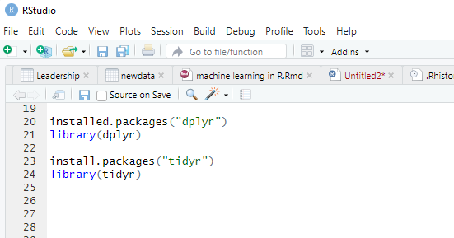
Dplyr Tutorial
Data analysis can be divided into three parts:
Extraction- First, we need to collect the data from many sources and combine them.
Transform- This step involves the data manipulation. Once we have consolidated all the sources of data, we can begin to clean the data.
Visualize- The last move is to visualize our data to check irregularity.
Important Packages for the next level
R has a library called dplyr to help in data transformation

Slide 34
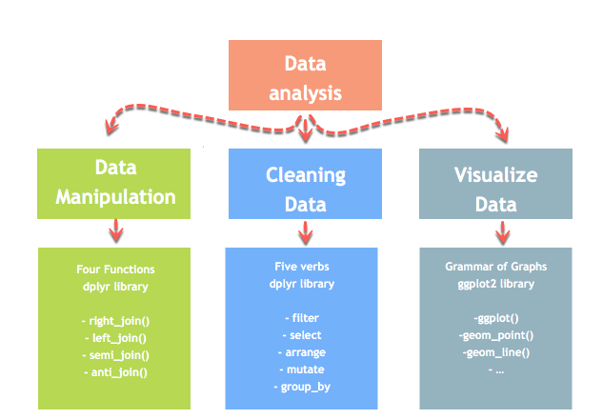
Data analysis
One of the most significant challenges faced by data scientists is the data manipulation. Data is never available in the desired format.
Data scientists need to spend at least half of their time, cleaning and manipulating the data. That is one of the most critical assignments in the job.
If the data manipulation process is not complete, precise and rigorous, the model will not perform correctly

Slide 35
LESSON 4
Functions

Slide 36
Merge Data Frames in R
To perform an analysis, we need to merge two dataframes together with one or more common key variables.
A full match returns values that have a counterpart in the destination table. The values that are not match won’t be return in the new data frame.
The partial match, however, return the missing values as NA.
merge(x, y, by.x = x, by.y = y)
Arguments:
-x: The origin data frame
-y: The data frame to merge
-by.x: The column used for merging in x data frame. Column x to merge on
-by.y: The column used for merging in y data frame. Column y to merge on
With partial merging, it is possible to keep the rows with no matching rows in the other data frame
merge(x, y, by.x = x, by.y = y, all.true=TRUE)

Slide 37
Merge Data Frames in R
Example:
Create First Dataset with variables
surname
nationality
Create Second Dataset with variables
surname
Movies
The common key variable is surname. We can merge both data and check if the dimensionality is 7×3.
We add stringsAsFactors=FALSE in the data frame because we don’t want R to convert string as factor, we want the variable to be treated as character.

Slide 38
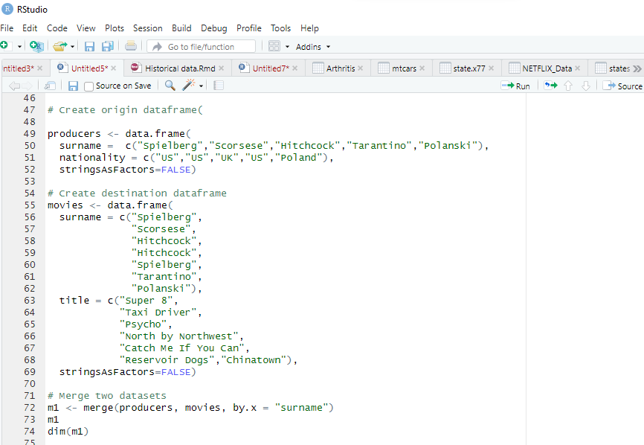
Full Merge

Slide 39
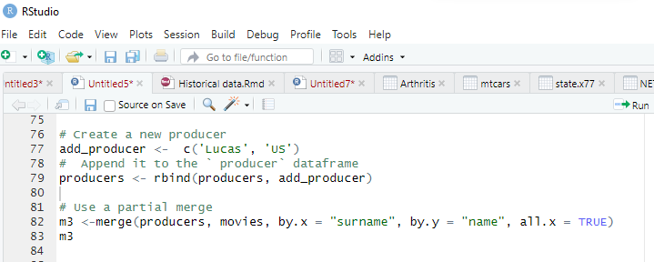
Partial merge
we can add a new producer, Lucas, in the producer data frame without the movie references in movies data frame. If we set all.x= FALSE, R will join only the matching values in both data set. In our case, the producer Lucas will not be join to the merge because it is missing from one dataset.
Let’s see the dimension of each output when we specify all.x= TRUE and when we don’t.

Slide 40
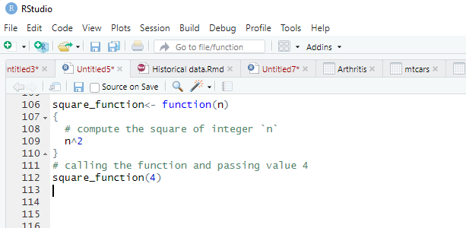
Functions in R Programming
A function, in a programming environment, is a set of instructions. A programmer builds a function to avoid repeating the same task, or reduce complexity.
Functions are useful when you want to perform a certain task multiple times. A function accepts input arguments and produces the output by executing valid R commands that are inside the function. In R Programming Language when you are creating a function the function name and the file in which you are creating the function need not be the same and you can have one or more function definitions in a single R file.
Types of function in R Language
Built-in Function: Built function R is sq(), mean(), max(), these function are directly call in the program by users.
User-defined Function: R language allow us to write our own function.
Syntax;
function (arglist) { #Function body }
General functions
The function is named square_function; it can be called whatever we want.
It receives an argument “n”. We didn’t specify the type of variable so that the user can pass an integer, a vector or a matrix
The function takes the input “n” and returns the square of the input.

Slide 41
Math functions
R has an array of mathematical functions.
Operator Description
abs(x) Takes the absolute value of x
log(x,base=y) Takes the logarithm of x with base y; if base is not specified, returns the natural logarithm
exp(x) Returns the exponential of x
sqrt(x) Returns the square root of x
factorial(x) Returns the factorial of x (x!)
Basic statistic functions
mean(x) Mean of x
median(x) Median of x
var(x) Variance of x
sd(x) Standard deviation of x
scale(x) Standard scores (z-scores) of x
quantile(x) The quartiles of x
summary(x) Summary of x: mean, min, max etc..

Slide 42
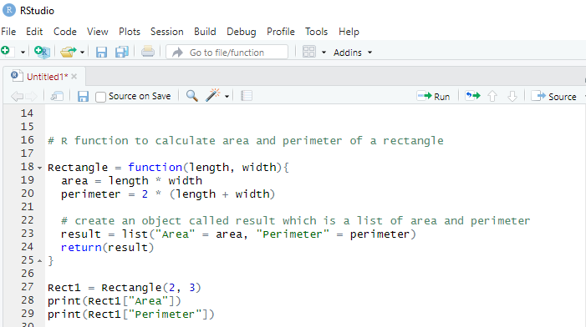
Write function in R
Syntax
function.name <- function(arguments) { computations on the arguments some other code }
Code Explanation
The function is named Rectangle; it can be called whatever we want.
It receives an argument “length and width”. We didn’t specify the type of variable so that the user can pass an integer, a vector or a matrix
The function takes the input “length and width” and returns the area and perimeter of the input.

Slide 43
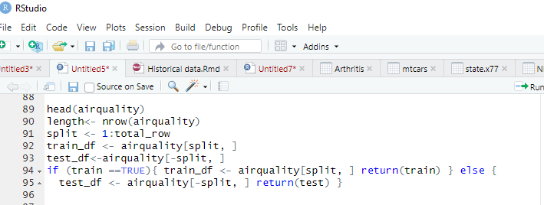
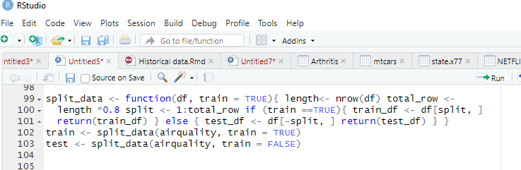
Function Cont.…
Using Airquality dataset in R
Using df data

